Slide 1
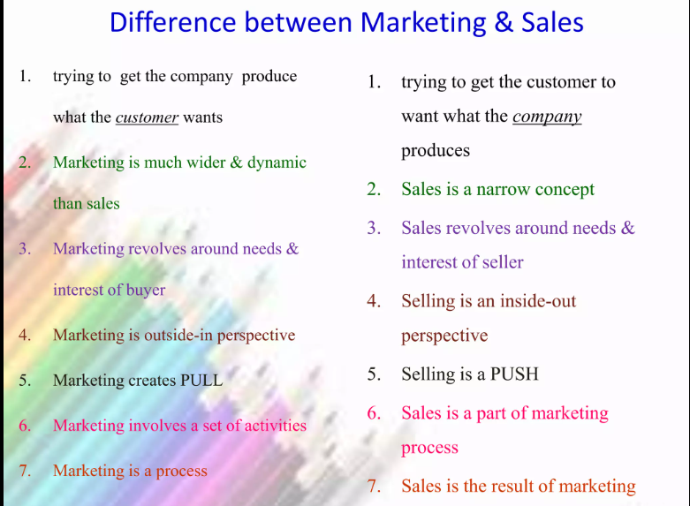
MARKETING
Sales

Slide 2
VENN DIAGRAM
Marketing
sales

